Slide 1

FEDERAL MEDICAL CENTRE – AZARE
HOSPITAL CLINICAL PRESENTATION,
ON
THE ROLE OF NURSES IN MENTAL HEALTH PROMOTION
PRESENTED BY
NURSING SERVICES DEPARTMENT
PRESENTER: Nr. UMAR GAZALI ISHAQ
DATE; 23RD AUGUST, 2023

Slide 2

Outline of contents
Introduction
Overview of Mental health & Illness
Strategies to Promote Mental Health
Role of the Nurses in promoting mental health
Challenges
Recommendations
Summary
Conclusion
References

Slide 3


Mental health is far more than the absence of mental illness.
It’s the successful balance between all aspects of life.
It’s the foundation for well-being and effective functioning.Mental health problems are not regarded as life threatening issues.

Slide 4

Definition of mental health .
Mental health is the successful adaptation to internal and external stressors as evidenced by thought, behavior, emotion and personality that are congruent with the societal norms, values and age appropriate (Mary Townsend, 2012).

Slide 5
DEFINATION.
WHO (2010) defined mental health as state of mental wellbeing that enables people to cope with the stresses of life, realize their abilities, learn well and work well and contribute to their community.

Slide 6
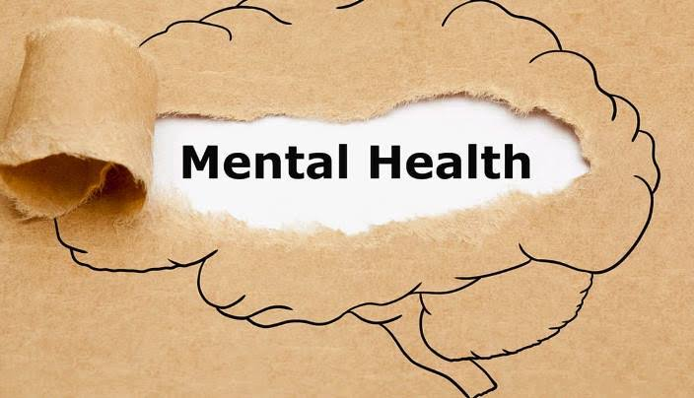
Definition of mental illness
Mental Illness is the mal-adaptation to internal and external stressors as evidenced by thought, behavior, emotion and personality that are incongruent with the societal norms, values and age appropriate (Mary Townsend, 2012).

Slide 7

Epidemiology/prevalence of mental illness
Developed countries (USA, UK. etc.) ; 5 – 25%
Developing countries (Nigeria, etc); 75 – 95% {WFMH, 2021}
Suicide occur every 40 seconds in the world
1:6 (10-19)yrs suffer mental health issues
1:4 Nigerian suffer mental health issues

Slide 8
FMC – AZARE STATISTICS, 2022
S/N | MONTH | No. of Patients
1 | JANUARY | 125
2 | FEBRUARY | 137
3 | MARCH | 135
4 | APRIL | 137
5 | MAY | 117
6 | JUNE | 120
7 | JULY | 150
8 | AUGUST | 126
9 | SEPTEMBER | 179
10 | OCTOBER | 141
11 | NOVEMBER | 144
12 | DECEMBER | 172
TOTAL |  | 1680
MALE: 30% (504)
FEMALE: 70% (1176)

Slide 9

s
Predisposing factors : Heredity, Constitutional factors.
Precipitating factors: Physical & Psychological factors.

Slide 10

SIGNS OF GOOD MENTAL HEALTH/ ILLNESS
SIGNS OF GOOD MENTAL HEALTH
Positive self concepts.
Adaptive functioning.

Slide 11

SIGNS OF POOR MENTAL HEALTH
Impaired self concept
Mal-adaptive functioning

Slide 12

Strategies to Promote Mental Health
Stress Management.
Assertive communication.
Anger management.
Work-life balance.
Positive thinking.
Social support.
Spirituality.

Slide 13

Role of nurses in mental health promotion
Data collection.
Interviewing, behavioral observation, physical and mental health assessment.
Plan appropriate interventions with the client.

Slide 14

NURSES ROLE……. Diagnosis
The nurse utilizes nursing diagnosis and/or standard classification of mental disorders.
Nursing logic basis for providing care rests on the recognition.
identification of those actual or potential health problems.

Slide 15

NURSES ROLE…….
The nurse develops a nursing care plan.
The nursing care plan is used to guide therapeutic interventions.

Slide 16


NURSES ROLE……..
Psychotherapeutic interventions
Health teaching
Activities of daily living
Somatic therapies
Therapeutic environment

Slide 17

NURSES ROLE……….
The nurse evaluates client responses to nursing actions
Revise the database, nursing diagnosis and nursing care plan.

Slide 18
NURSES ROLE……… Cont.
Interdisciplinary Collaboration
The nurse collaborates with other health care providers in Nursing process and other mental health activities.

Slide 19

NURSES ROLE..... Cont.
Utilization of Community Health Systems
The nurse participates with community members in nursing process
promotion of the brand continuum of primary, secondary and tertiary prevention of mental illness.

Slide 20

Limited manpower.
Lack of dedicated unit and other infrastructures.
High level of stigma/discrimination.
Limited awareness on mental health/psychiatry services.

Slide 21

Urgent need for mental health/psychiatric professionals.
Urgent need for dedicated mental health psychiatric unit.
Ensuring community awareness on mental health services.
Training and retraining of staff.

Slide 22

Promoting mental health is major concern in the prevention and control of major NCDs.
Between 75-95% of people with mental disorders do not have access to mental health services and thus, live in low and middle-income countries.
Suicide occur every 40 seconds globally.
1:6 of adolescence aged 16-19 yrs suffer mental health issues .
1:4 Nigerians suffer mental health issues.

Slide 23

Mental health promotion is a basic necessity for fruitful and healthy living. Mental health is a total health.

Slide 24

References
Baker P. (2009): Psychiatric And Mental Health Nursing; The Craft Of Caring. 2nd Edition Edward Arnold Publishers Ltd, UK
Tasman A., Kay J., (2006) Essentials Of Psychiatry, 2nd Edition, John Wiley& Sons, Ltd USA
WHO, 2022 Mental Health: Strengthening Mental Health Promotion. Fact Sheet No. 220.WHO, Geneva. Retrieved From: Http://Www.Who.Int//Mediacentre/Factsheet
WHO, (2015) Prompting Mental Health: Concepts, Emerging Evidence And Practice, WHO Geneva.

Slide 25

THANK YOU FOR LISTENING

